Slide 1
SAT vs ACT Analysis
Ling Chong Gold

Slide 2
Agenda
Background
Problem Statement
Obtaining Data
Exploring Data
SAT vs ACT Year On Year
Colorado and Illinois
Rhode Island
Where Should We Focus On

Slide 3
Background
SAT was created to standardize college admissions procedures and increase access to higher education
In 1959, ACT was introduced
SAT went through a few major revisions
1994 – antonyms was removed, reading passages was were improved to more closely resemble materials taught in college courses and use of calculator was permissible
2005 – Elimination of certain types of questions that featured analogies and introduction of the 2400 point scoring system with required essay section
2016 – Some of the above changes was reversed in response to competition from ACT
Source : https://www.manhattanreview.com/sat-history/

Slide 4
Problem Statement
How does SAT fare against ACT in participation and how can we increase the participation rate for SAT and which state should we focus on?
An analysis was performed for data collected for year 2017 and 2018
In depth look was performed on Colorado, Illinois, Ohio and Rhode Island which display the highest growth rate for either SAT or ACT

Slide 5
Obtaining Data
2017 and 2018 Data for individual state’s ACT and SAT scoring and participation was provided
2018’s ACT ‘s data was incomplete
Additional data was obtained from publicly available open sources
Check was performed on data’s veracity through mathematical computation
Cleansing was performed and data was merged for further analysis
Source: https://magoosh.com/hs/act/2016/average-act-score-by-state/

Slide 6
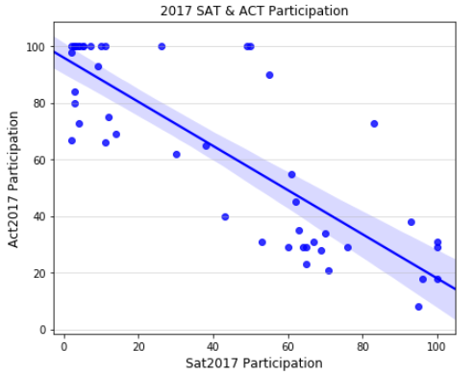
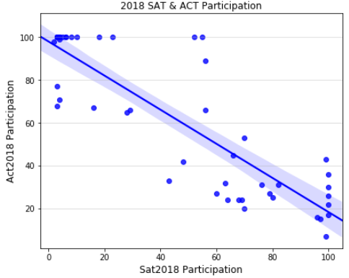
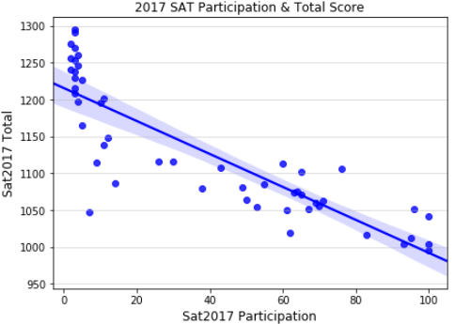
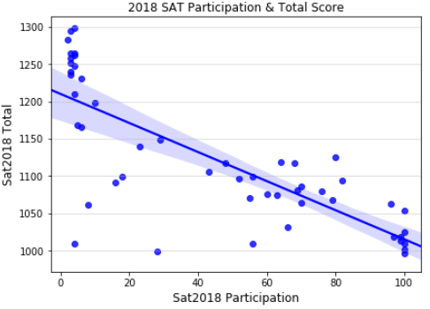
Exploring Data
Check was performed on data’s veracity through mathematical computation
Cleansing was performed and data was merged for further analysis
During the exploratory phase, some useful trends were observed
2018 ACT Data Source: https://magoosh.com/hs/act/2016/average-act-score-by-state/

Slide 7
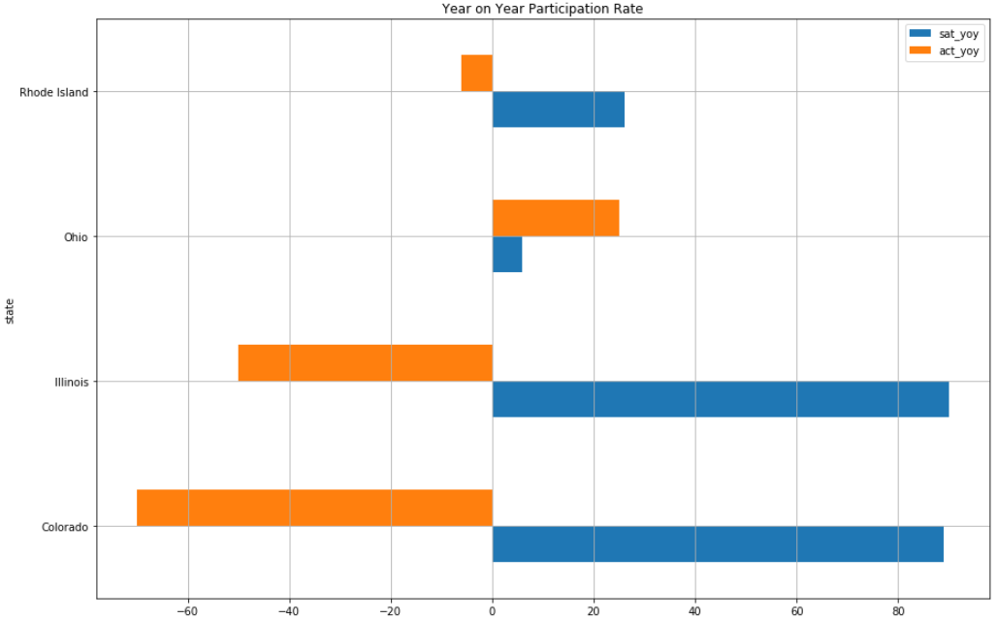
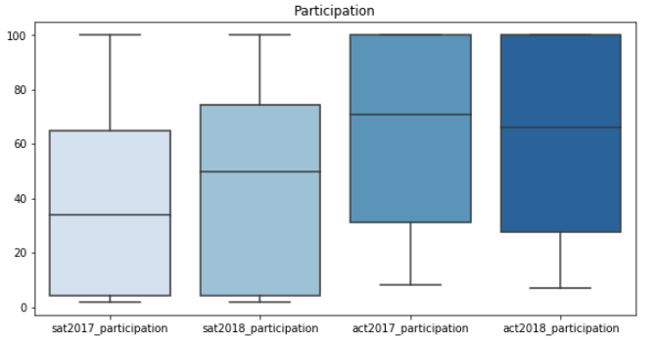
SAT vs ACT Year on Year
ACT has a higher participation rate compared to SAT
States displaying growth rate of more than 20% for each test is displayed

Slide 8
Colorado and Illinois
Since 2001, Colorado juniors has been required to take the ACT
In 2015, the state Department of Education chose The College Board
SAT has a reputation of being more reason-based and focused on critical thinking compared to ACT being more fact-recall test
Source: https://www.chalkbeat.org/posts/co/2015/12/23/goodbye-act-hello-sat-a-significant-change-for-colorado-high-schoolers/
For the past 15 years, Illinois has been giving students the ACT
The College Board won a bid with the State
High school juniors will not be charged for taking the SAT
Free college entrance exam has been popular
Source: https://www.chicagotribune.com/news/ct-illinois-chooses-sat-met-20160211-story.html#targetText=Illinois%20moves%20ahead%20with%20new%20testing%20plan%2C%20replacing%20ACT%20with%20SAT&targetText=It's%20official%2C%20according%20to%20the,into%20Illinois%20public%20high%20schools.

Slide 9
Rhode Island
All the flagship universities in the state have held on to the SAT as a prerequisite for admission
Rhode Island is also one of the 10 states that give the SAT to students for free
6 Schools in the Rhode Island have made submitting ACT or SAT scores optional for college admission
Source: https://www.providencejournal.com/news/20181025/with-sat-required-ri-sees-jump-in-participation-decline-in-scores
Source: https://www.providencejournal.com/news/20180625/sat-requirement-waning-in-ri-and-nationally--poll

Slide 10
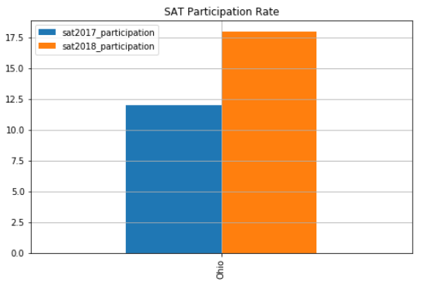
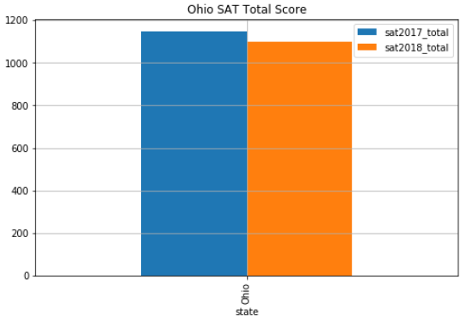
Recommendations - Ohio
The increase of participation rates should be gradual
Work with the state Department of Education to make SAT mandatory
Free tests are popular amongst parents and students
Ohio pays for the students to take either the ACT or SAT
Work with Ohio’s Department of Education to make SAT mandatory
Ohio’s participation rate in 2018 is healthy, increasing participation will not drastically decrease total score
Source: https://www.dispatch.com/news/20170228/ohio-schools-must-now-give-act-or-sat-to-all-juniors

